Slide 1
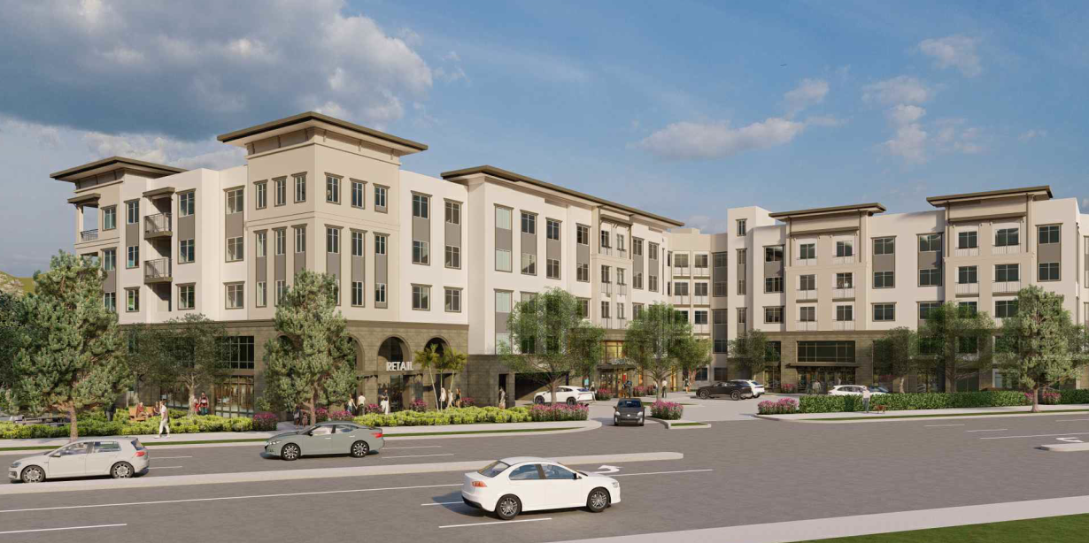
Mixed-use development 1941 White Avenue
Development Review Committee Meeting
June 25, 2024
Development Review Committee Meeting
June 25, 2024

Slide 2
Introduction
Project Overview
Mixed-use development combining residential and commercial spaces
Project location and applicant details
Key Figures
Total residential units: 367
Affordable units: 44
Commercial space: 1,588 sq ft
Parking spaces: 518

Slide 3
Project details
Residential Unit Breakdown
58 studios
182 one-bedroom
119 two-bedroom
8 three-bedroom
Affordable Housing
26 units for lower-income households
18 units for very-low-income households

Slide 4
Site description and history
Current State
Former paper mill site with existing industrial buildings
Location
Bounded by White Avenue, Arrow Highway, and railroad tracks
Site Size: 4.8 acres

Slide 5
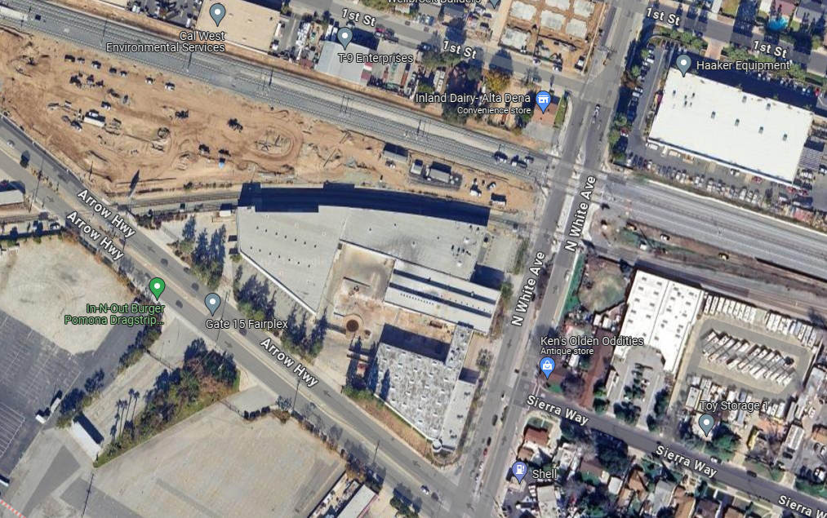

Slide 6
Regulatory compliance
General Plan and Zoning
Current General Plan designation of Commercial/Business Park
General Plan Update will include a change to Specific Plan
Zoned under Old Town La Verne Specific Plan (OTLVSP), Mixed-Use 1 District
Submitted Applications
Precise Plan Review, Lot Merger, Density Bonus, Tree Removal

Slide 7
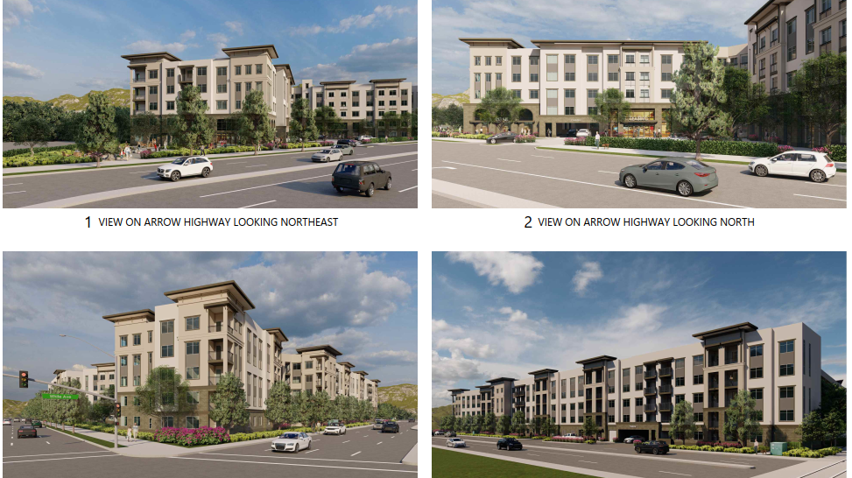
Elevations/Architecture

Slide 8
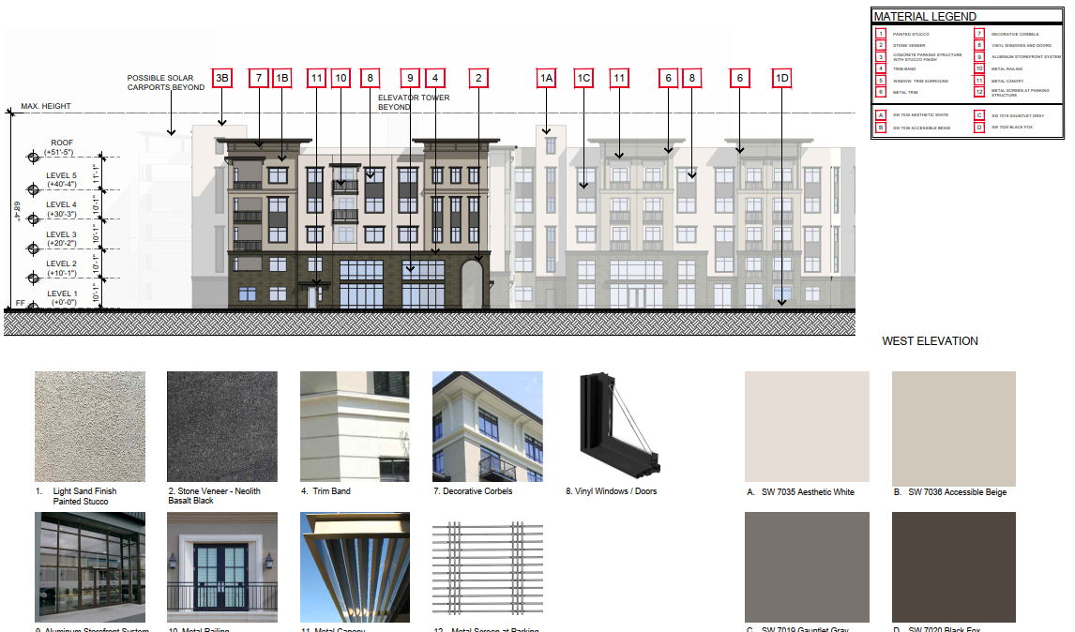

Slide 9
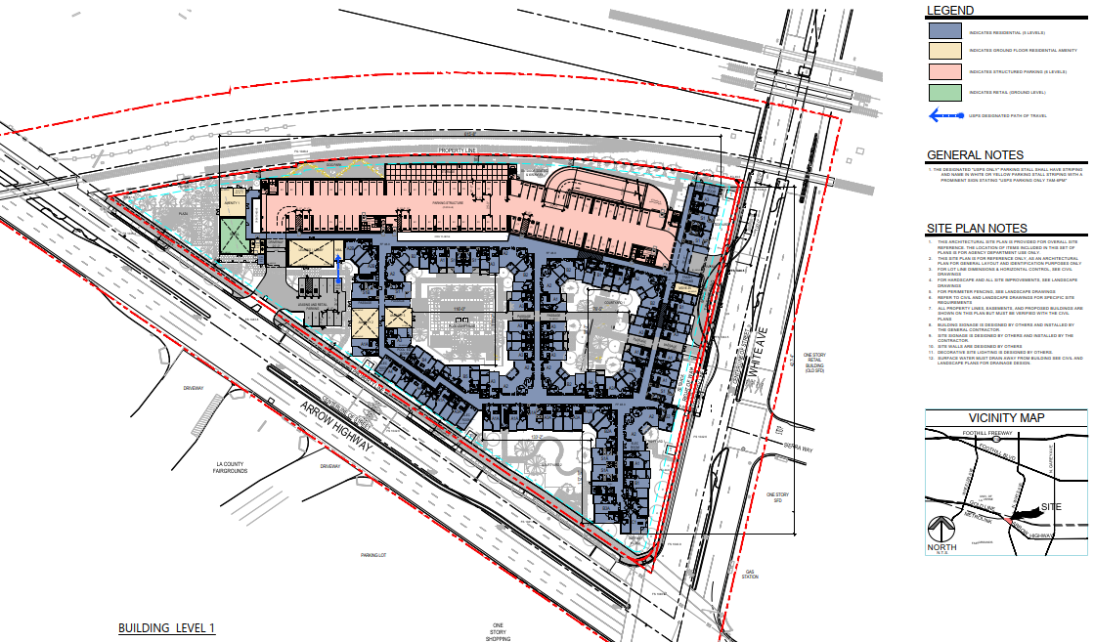
Site Plan

Slide 10
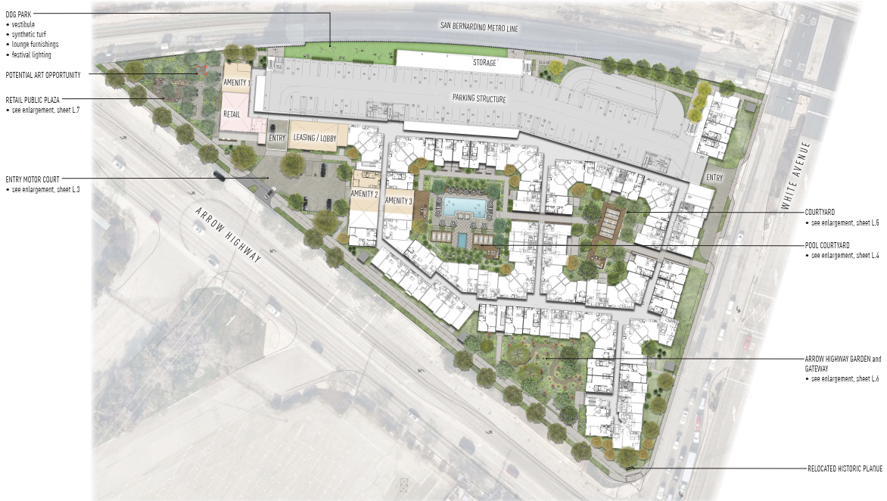

Slide 11
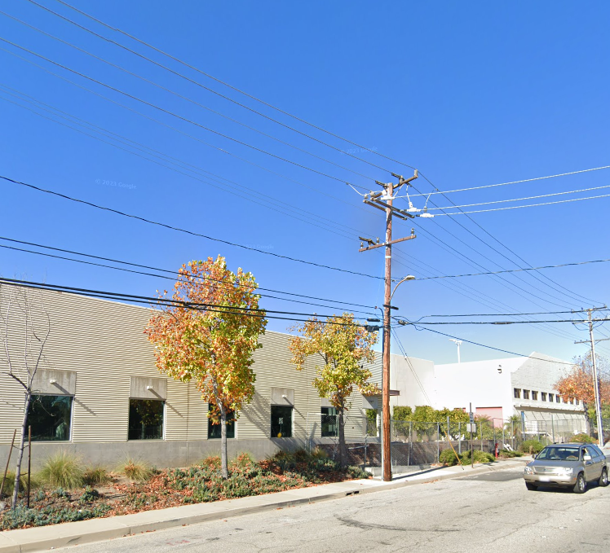
Underground Utility District No. 8
White Avenue and Arrow Highway, adjacent to the project site, are within UUD No. 8. Utilities currently located along White Avenue will be placed underground as part of the project.

Slide 12
Community Facilities District (CFD)
Added Condition of Approval #25
The Applicant is hereby required to initiate the process under the Mello-Roos Community Facilities Act to annex the project site into the applicable Community Facilities District (CFD), either CFD 11-1 or the new CFD currently being studied by the City which would be CFD 24-1. The following requirements shall apply:
The Applicant shall adhere to all rules, regulations, and financial obligations associated with CFD 24-1 or 11-1, including but not limited to any special taxes, assessments, and maintenance fees as determined by the City. The City will confer with Applicant, upon request by the Applicant, prior to annexation to understand any concerns about potential project financial infeasibility based on the imposition of CFD 24-1 or 11-1, and the City will make good faith efforts to address those concerns by, for example, adjusting applicable taxes, assessments, and fees applicable to the Project under either CFD 11-1 or 24-1. Nothing herein shall affect the rights of property owners or electors within CFD 11-1 or CFD 24-1 to make future changes to CFD 11-1 or CFD 24-1 following annexation into the district.
Upon successful annexation into CFD 24-1 or 11-1, the Applicant shall provide the City with all final documentation confirming the annexation.
A copy of the annexation agreement, recorded documents, and proof of compliance with CFD 24-1 or 11-1 obligations must be submitted to the Community Development Department prior to the issuance of building permits.

Slide 13
Ceqa compliance
The project qualifies for exemptions under several CEQA provisions:
Public Resources Code 21155.4 and CEQA Guidelines Section 15182(b): The project is a transit priority mixed-use project consistent with the Old Town La Verne Specific Plan, which had a certified Environmental Impact Report (EIR), and is consistent with Connect SoCal, the regional transportation plan for the SCAG region.
Government Code Section 65457 and CEQA Guidelines Section 15182(c): The project involves residential development under the Old Town La Verne Specific Plan, with an EIR prepared and certified post-1980.
Regarding categorical exemption under CEQA Guidelines Section 15332, the project qualifies as an infill project because it:
Occupies a site of less than 5 acres.
The site has been fully developed and has no significant habitat value.
There are no significant effects expected on traffic, noise, air quality, or water quality.
All necessary utilities and public services are available to the site.
None of the exceptions to these exemptions are applicable to this project, as detailed in the categorical exemption report.

Slide 14
Project compliance
Height and Lot Coverage
Proposed height: 69 feet (72’ max in OTLVSP)
Lot coverage: 60% (waiver requested under Density Bonus Law) (50% max in GP)
Parking
518 spaces (compliant OTLVSP)

Slide 15
Housing Element (RHNA)
2021-2029 RHNA Allocation:
Total units: 1,346
Remaining units: 1,161
Very low: 408
Low: 234
Moderate: 210
Above moderate: 309
Project Contribution:
Total units: 367
Above moderate: 322
Low: 26
Very low: 18

Slide 16
No Net loss
 | Very Low + Low | Moderate | Above | Total
RHNA | 653 | 223 | 470 | 1,346
HE Credits for built and Under construction | 11 | 13 | 161
RHNA after Credits | 642 | 210 | 309 | 1,161
HE – Site Strategy | 1,015 | 160 | 200 | 1,375
SURPLUS | 373 | -50 | -91 | 232
1941 PROJECT SITE ASSIGNMENT IN HE – Table 5-8 | 155 | 8 | 9
1941 PROJECT PROVIDING | 44 | 0 | 322
SHORTFALL | -111 | -8 | +313
SURPLUS/DEFICIT | 261 | -58 | 222

Slide 17
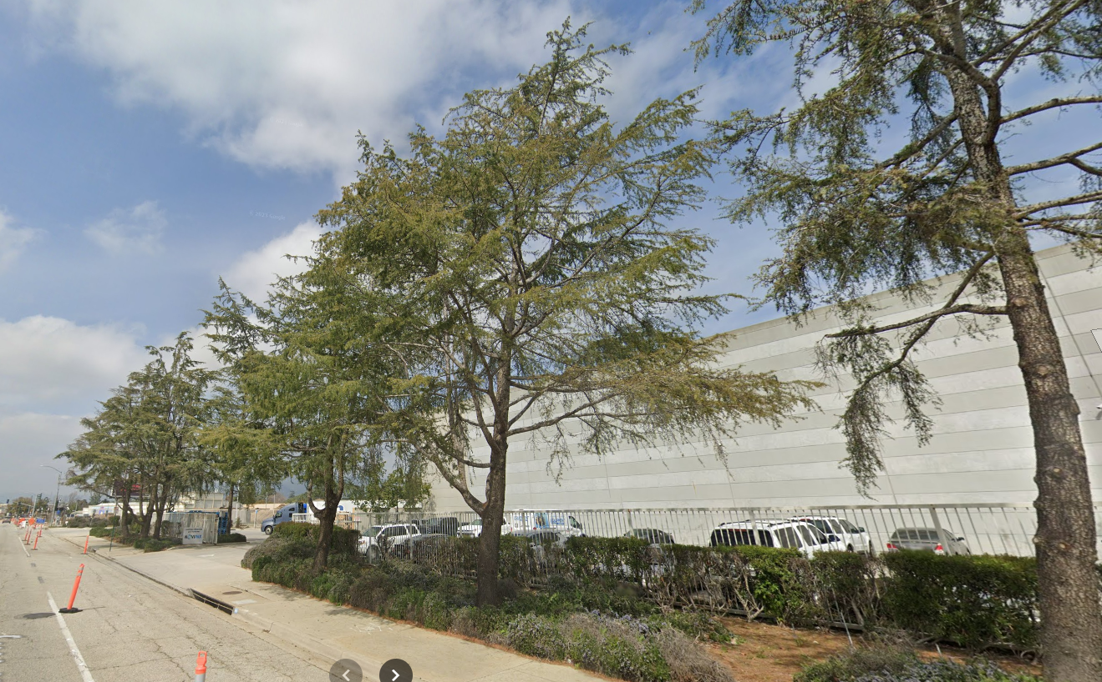
Tree removal and landscaping
Tree Removal
13 deodar cedars to be removed
Replacement plan
Planting of 163 new trees
Use of native and drought-tolerant species

Slide 18
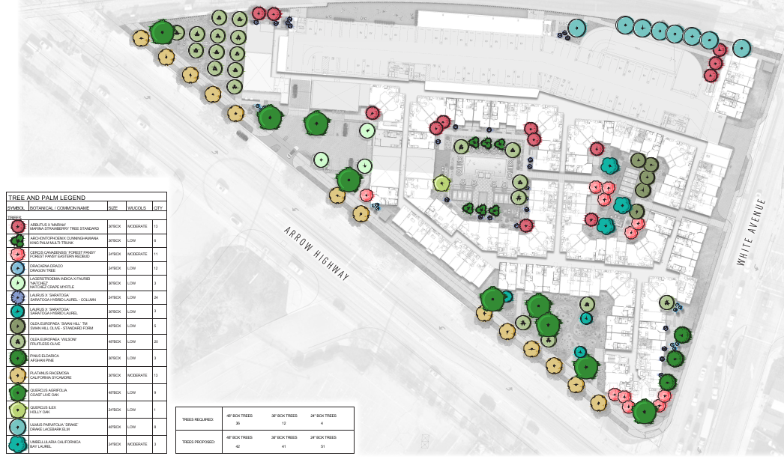

Slide 19
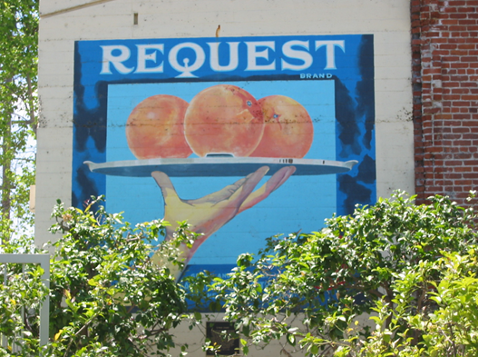
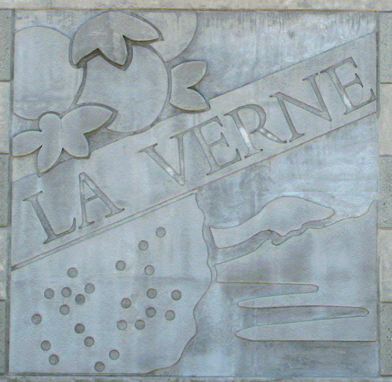
Public Art

Slide 20
Recommendation
A notice of public hearing was published in the Inland Valley Daily Bulletin on June 14, 2024, and notices were mailed to all property owners within 300 feet of the subject property on June 13, 2024. Notices were also posted at City Hall and on the City’s website on June 13, 2024.
Staff has not received any inquiries about the proposal and there have been no concerns raised.
Staff Recommendation
Approval of Case Nos. 77-23PPR, 26-24TR, 27-24LM, and 28-24DB
Compliance with OTLVSP and environmental regulations
Conditions of Approval

